Slide 1
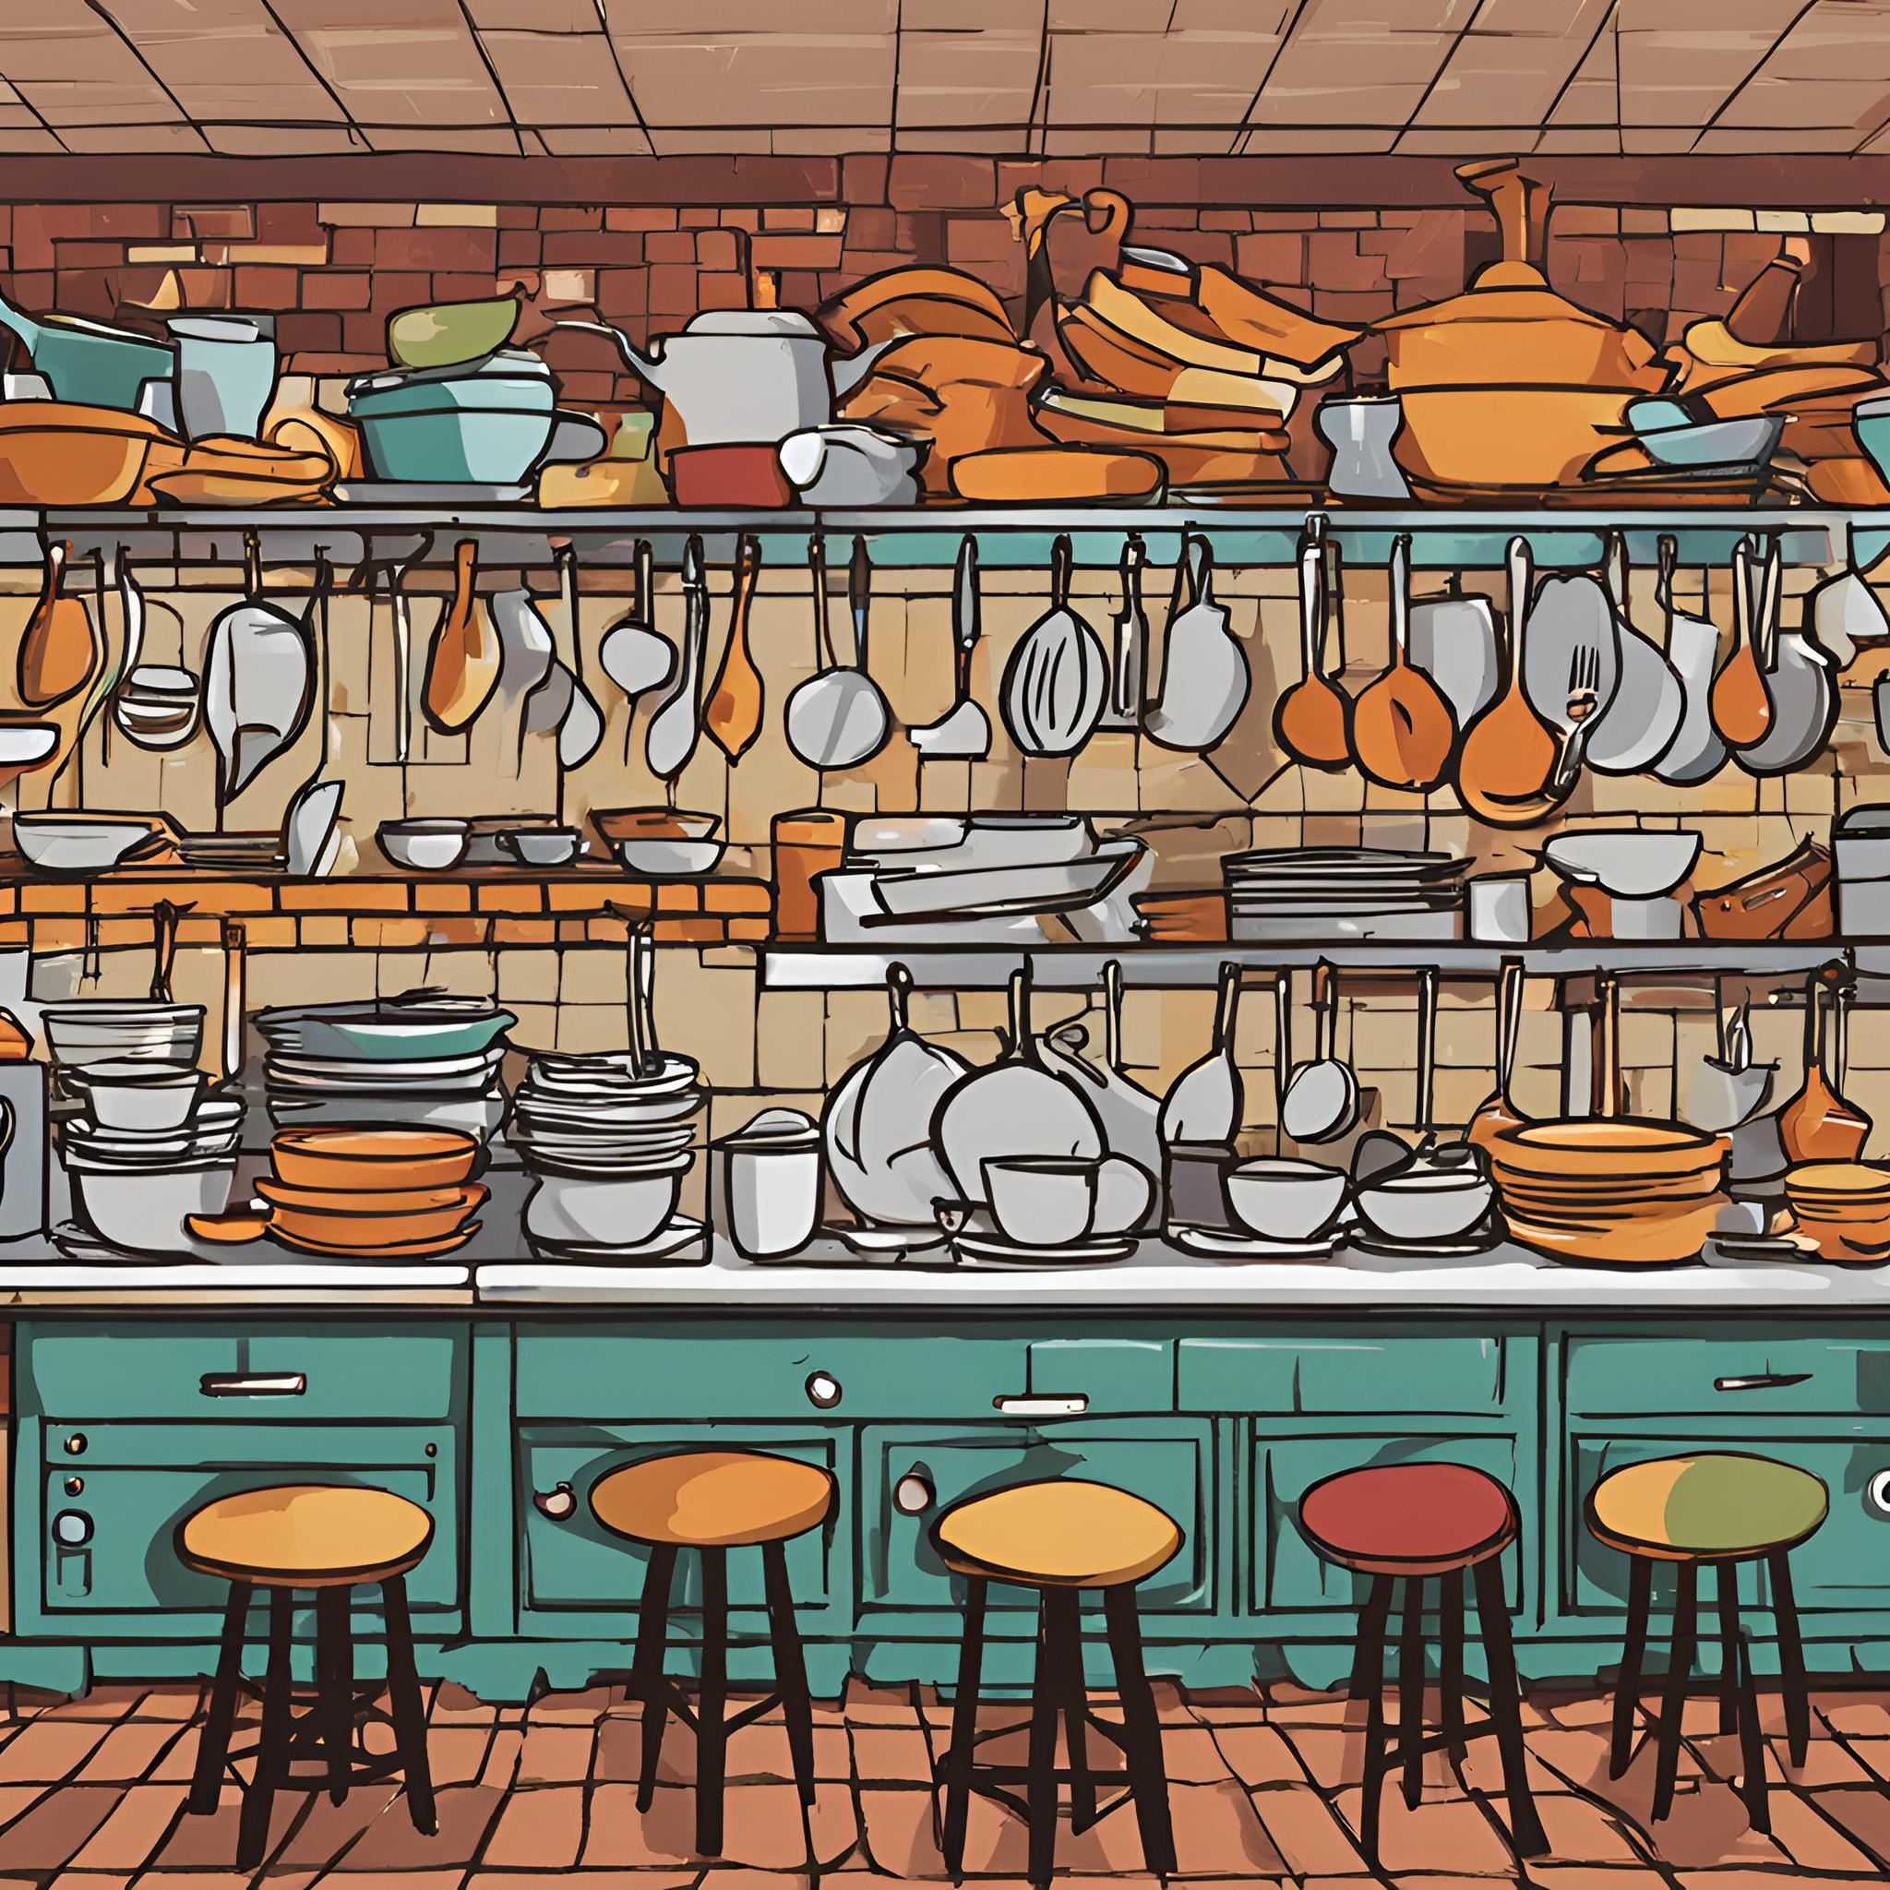
CRAZY KITCHEN
RESTAURANT
DBMS
Final Project IE 6700 Summer 2 2024
Rohan Reddy Pathi
Yuandi Tang

Slide 2
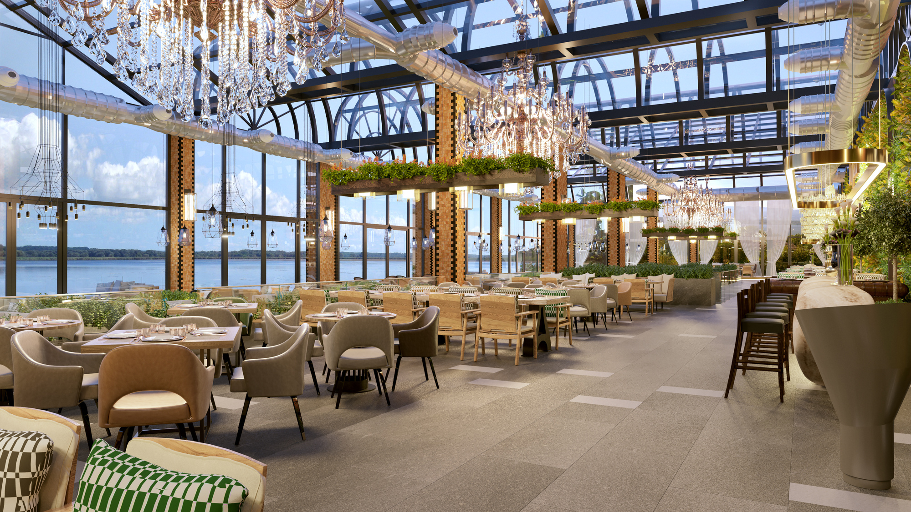
TOPICS
1. DATABASE DESIGN
2. DATABASE IMPLEMENTATION
3. NoSQL IMPLEMENTATION
4. ANALYTICS

Slide 3

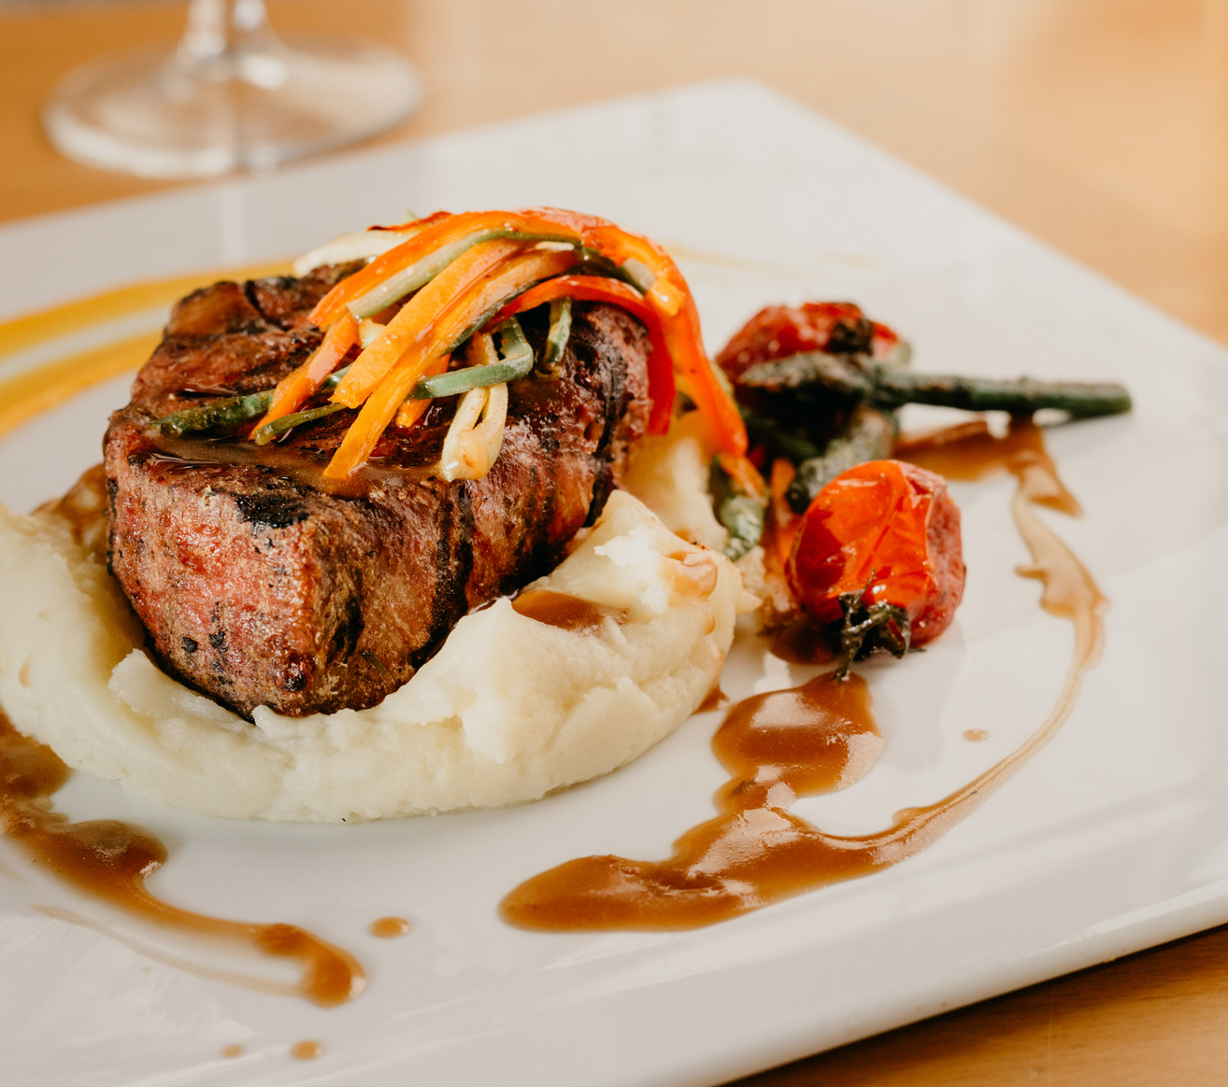
DATABASE DESIGN

Slide 4
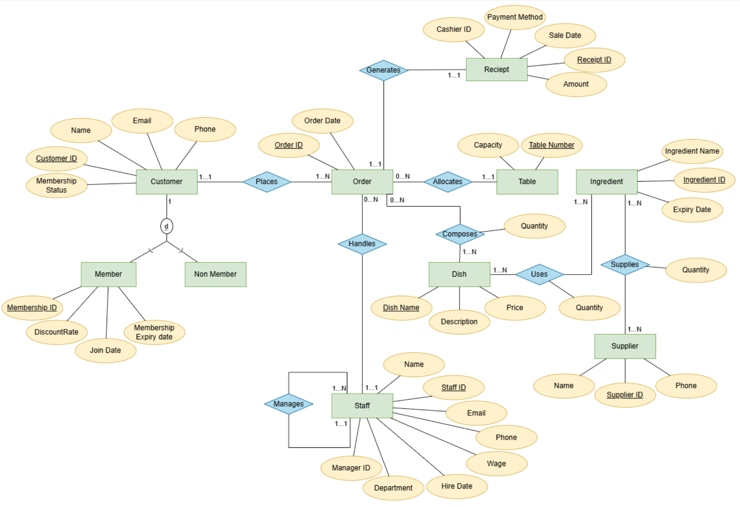
EER

Slide 5
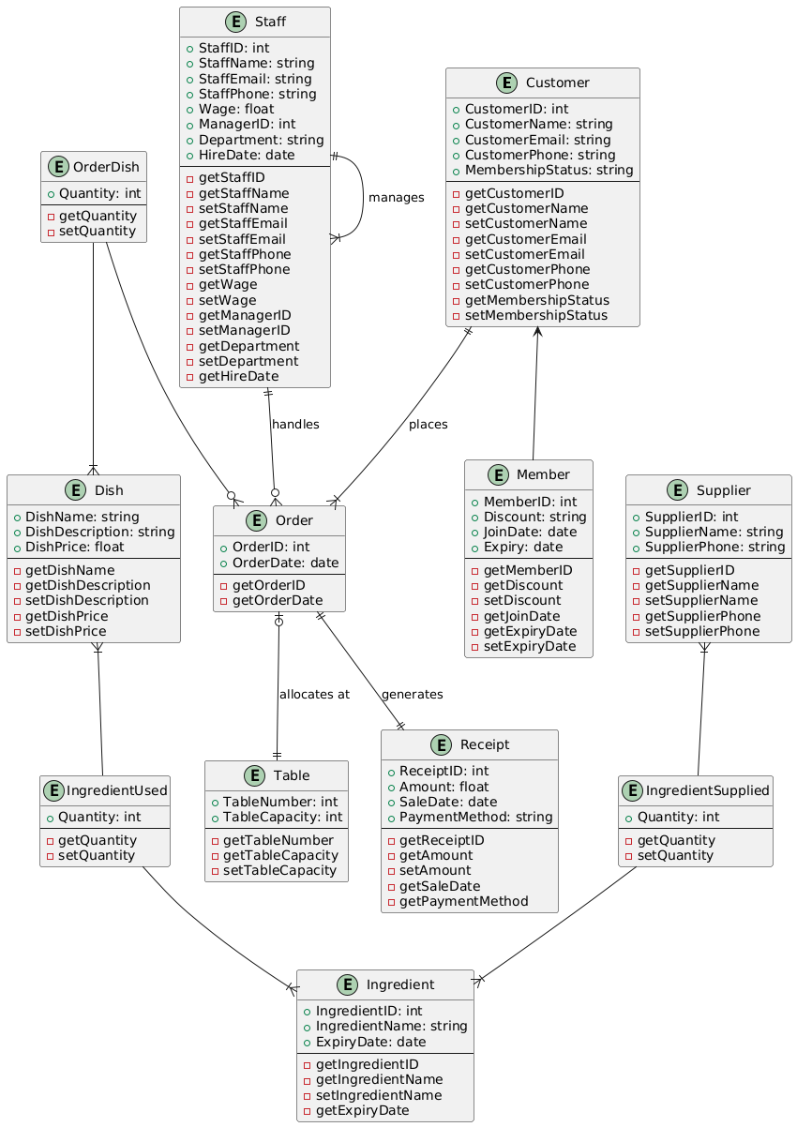
UML
CLASS
DIAGRAM

Slide 6
DATABASE
IMPLEMENTATION

Slide 7
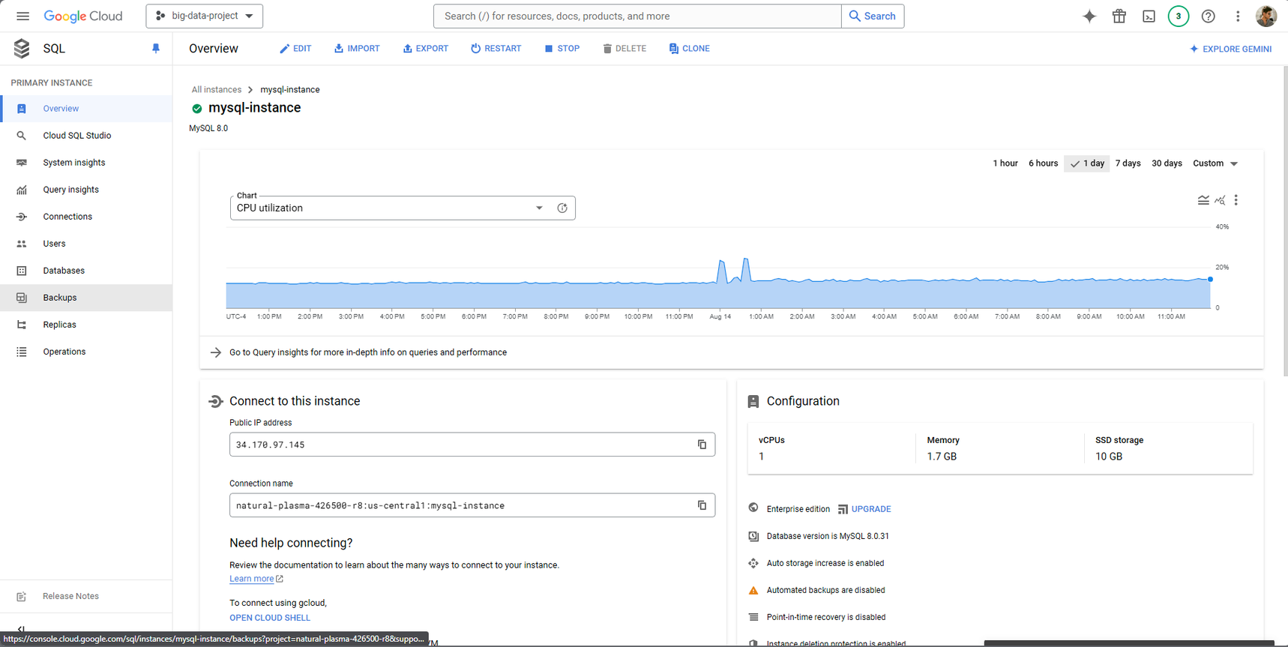
DEPLOYEMENT IN GOOGLE CLOUD

Slide 8
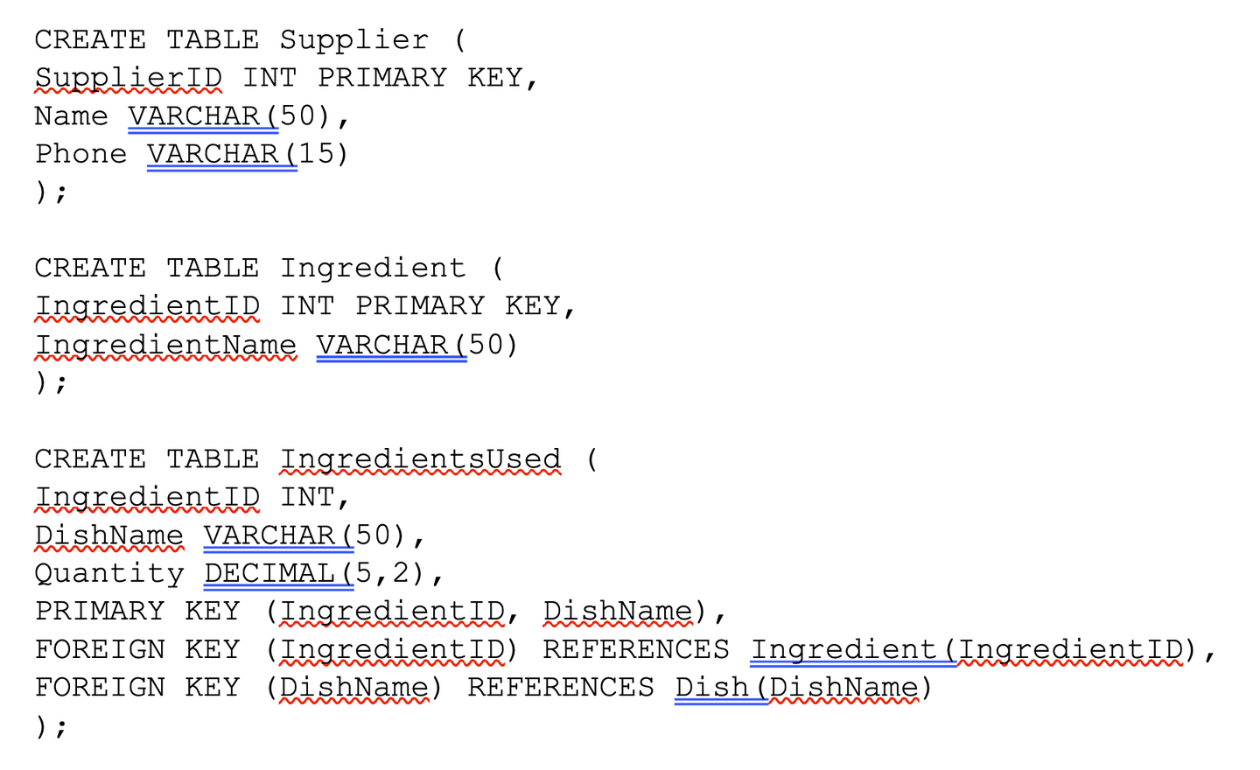
DDL COMMANDS

Slide 9
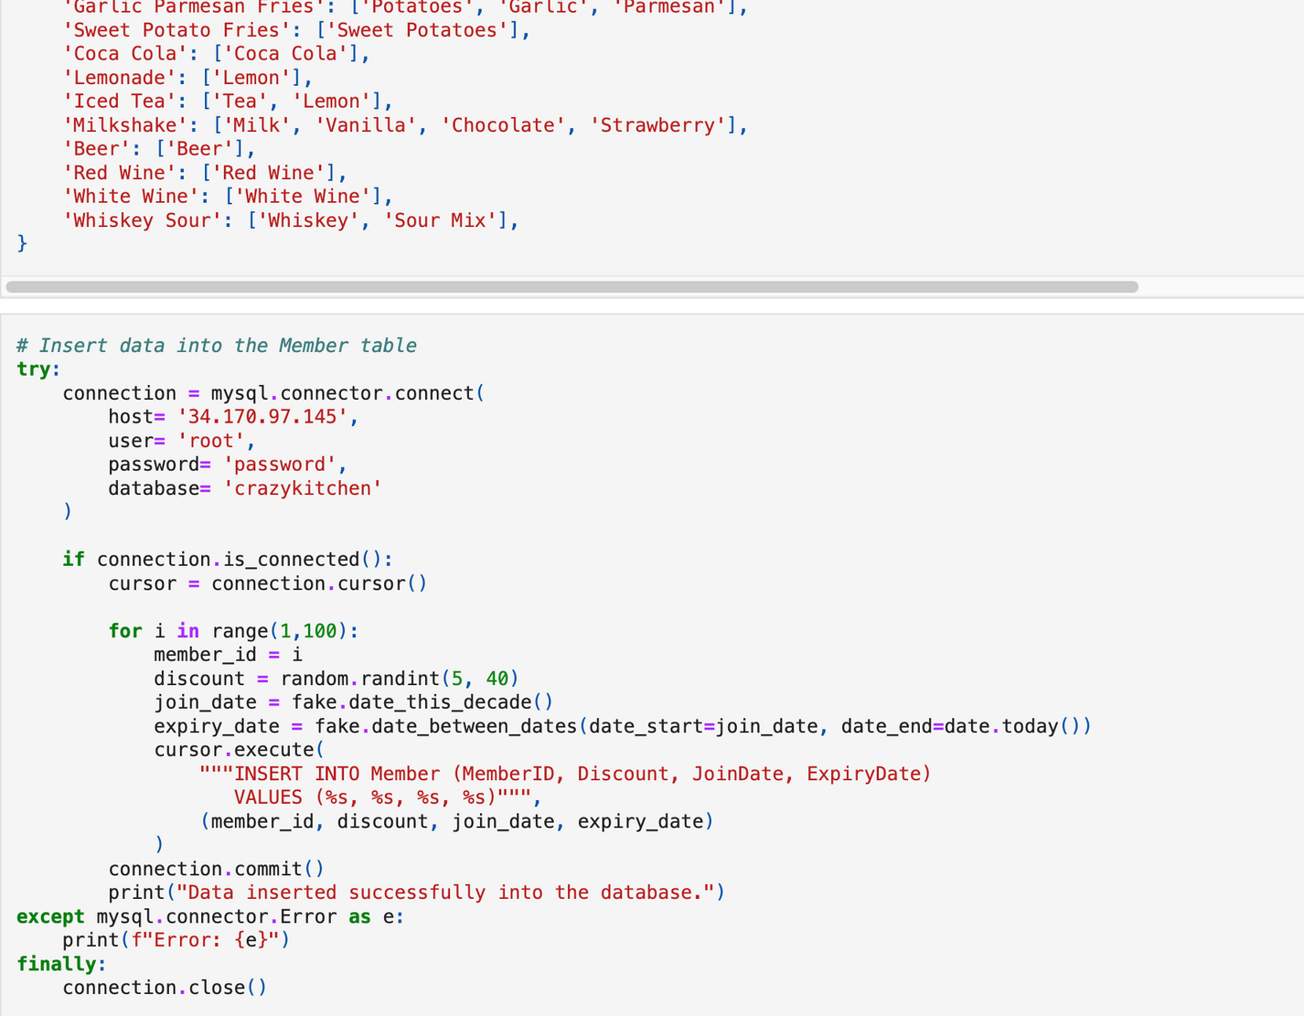
DATA INSERTION USING PYTHON

Slide 10

SQL ANALYTICAL
QUERIES

Slide 11
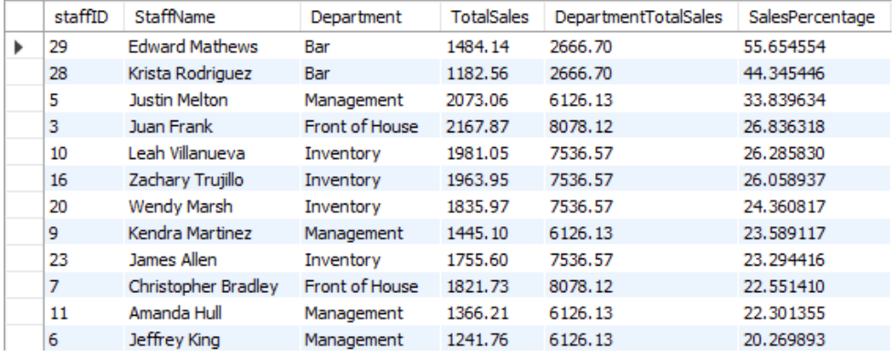
SALES PERFORMANCE OF STAFF WITH RESPECT TO DEPARTMENT
WITH StaffSales AS (
SELECT s.StaffID, s.Name AS StaffName, s.Department,
SUM(r.Amount) AS TotalSales
FROM Receipt r
JOIN RestaurantOrder o ON r.OrderID = o.OrderID
JOIN Staff s ON o.StaffID = s.StaffID
GROUP BY s.StaffID
),
DepartmentSales AS (
SELECT Department, SUM(TotalSales) AS DepartmentTotalSales
FROM StaffSales
GROUP BY Department
)
SELECT ss.staffID, ss.StaffName, ss.Department, ss.TotalSales, ds.DepartmentTotalSales,
(ss.TotalSales / ds.DepartmentTotalSales) * 100 AS SalesPercentage
FROM StaffSales ss
JOIN DepartmentSales ds ON ss.Department = ds.Department
ORDER BY SalesPercentage DESC;

Slide 12
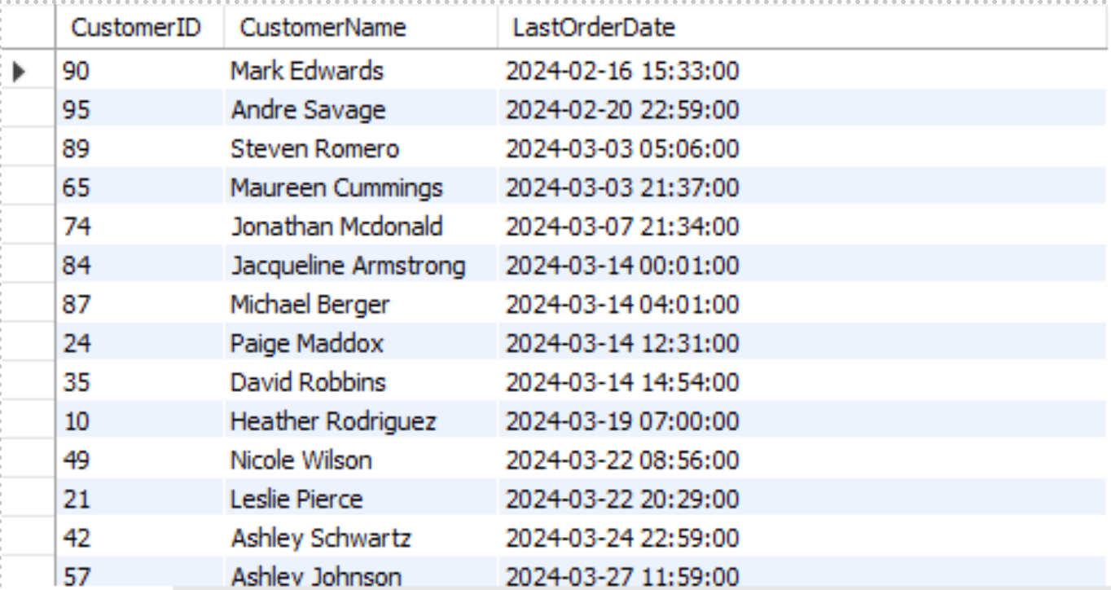
IDENTIFY CUSTOMERS WHO HAVE NOT ORDERED ANYTHING IN THE LAST 7 DAYS
SELECT C.CustomerID, C.Name AS CustomerName,
MAX(O.OrderDatetime) AS LastOrderDate
FROM Customer C
LEFT JOIN RestaurantOrder O ON C.CustomerID = O.CustomerID
GROUP BY C.CustomerID, C.Name
HAVING MAX(O.OrderDatetime) < CURDATE() - INTERVAL 7 DAY
ORDER BY LastOrderDate;

Slide 13
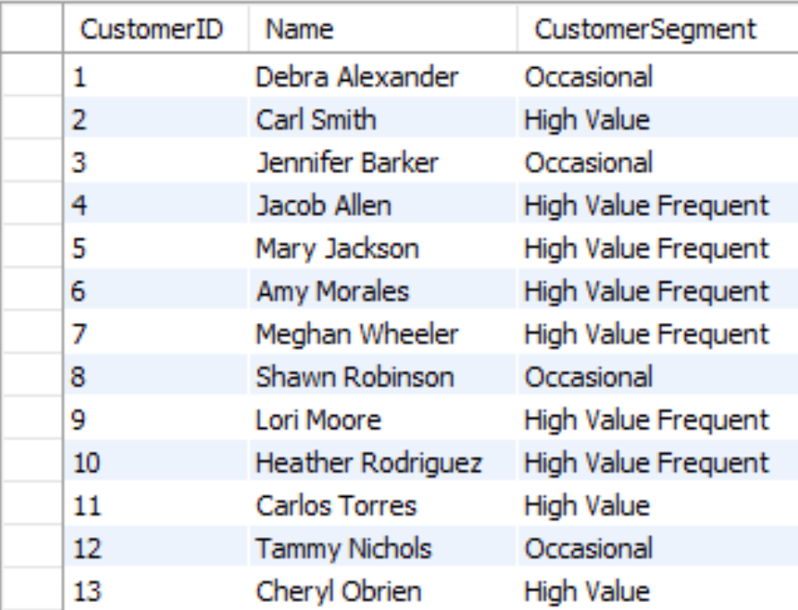
CUSTOMER SEGMENTATION BASED ON SPEND AND FREQUENCY
SELECT c.CustomerID, c.Name,
CASE
WHEN TotalSpent > 500 AND TotalOrders > 10
THEN 'High Value Frequent'
WHEN TotalSpent > 500 THEN 'High Value'
WHEN TotalOrders > 10 THEN 'Frequent'
ELSE 'Occasional'
END AS CustomerSegment
FROM Customer c JOIN (
SELECT CustomerID,
SUM(r.Amount) AS TotalSpent,
COUNT(o.OrderID) AS TotalOrders
FROM Receipt r
JOIN RestaurantOrder o ON r.OrderID = o.OrderID
GROUP BY CustomerID

Slide 14
NoSQL IMPLEMENTATION USING MongoDB

Slide 15
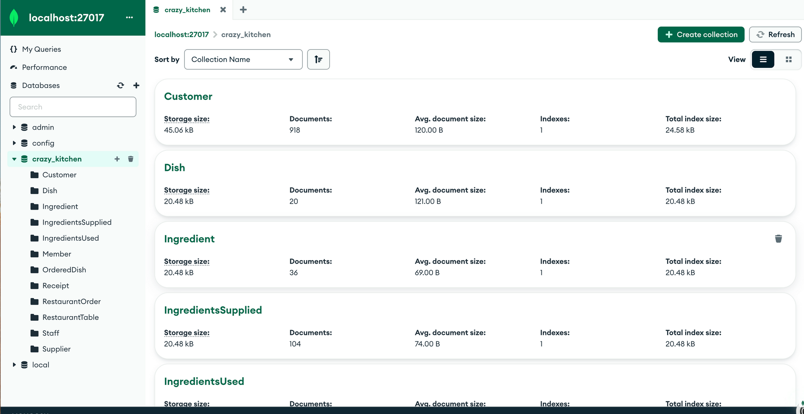
MIGRATING DATABASE FROM MYSQL TO MONGO
Notes:
Open MongoDB Compass and show the aggregation pipelines.

Slide 16

ANALYTICAL VISUALIZATION WITH PYTHON

Slide 17
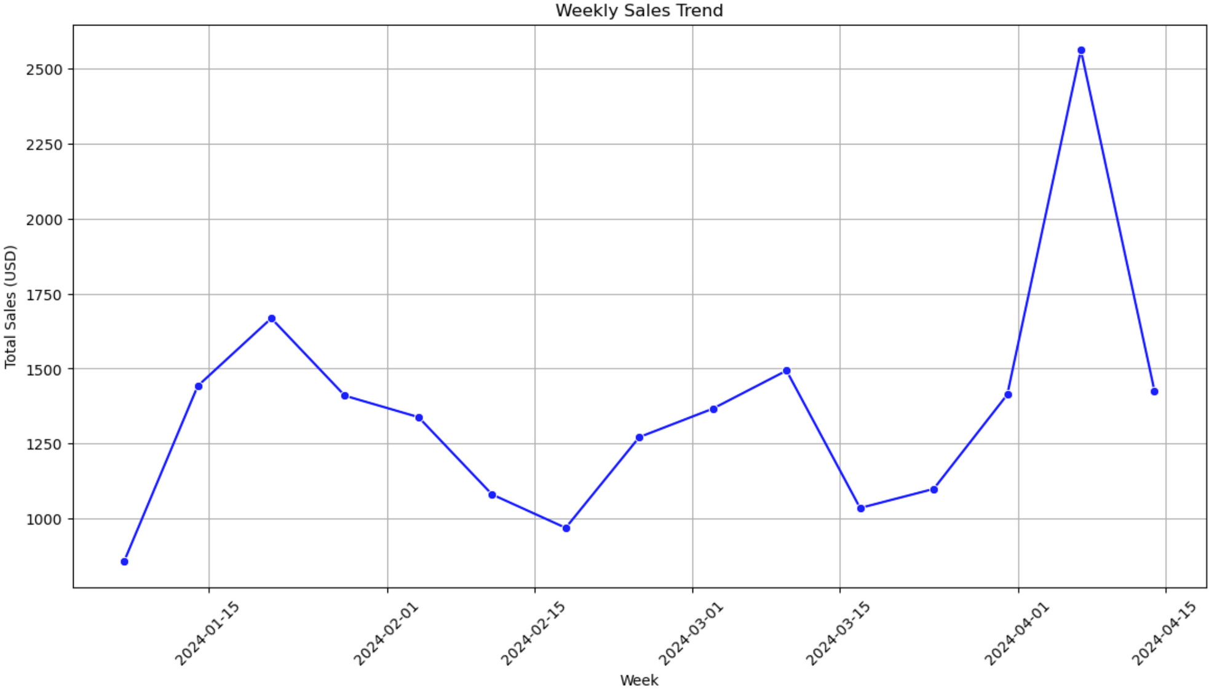
WEEKLY SALES TREND

Slide 18
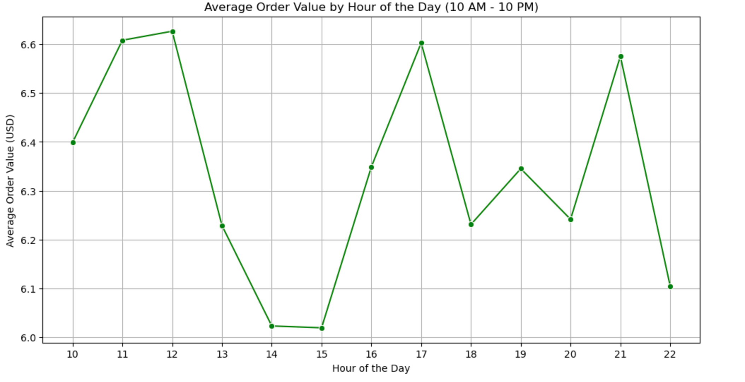
AVERAGE ORDER BY HOUR

Slide 19
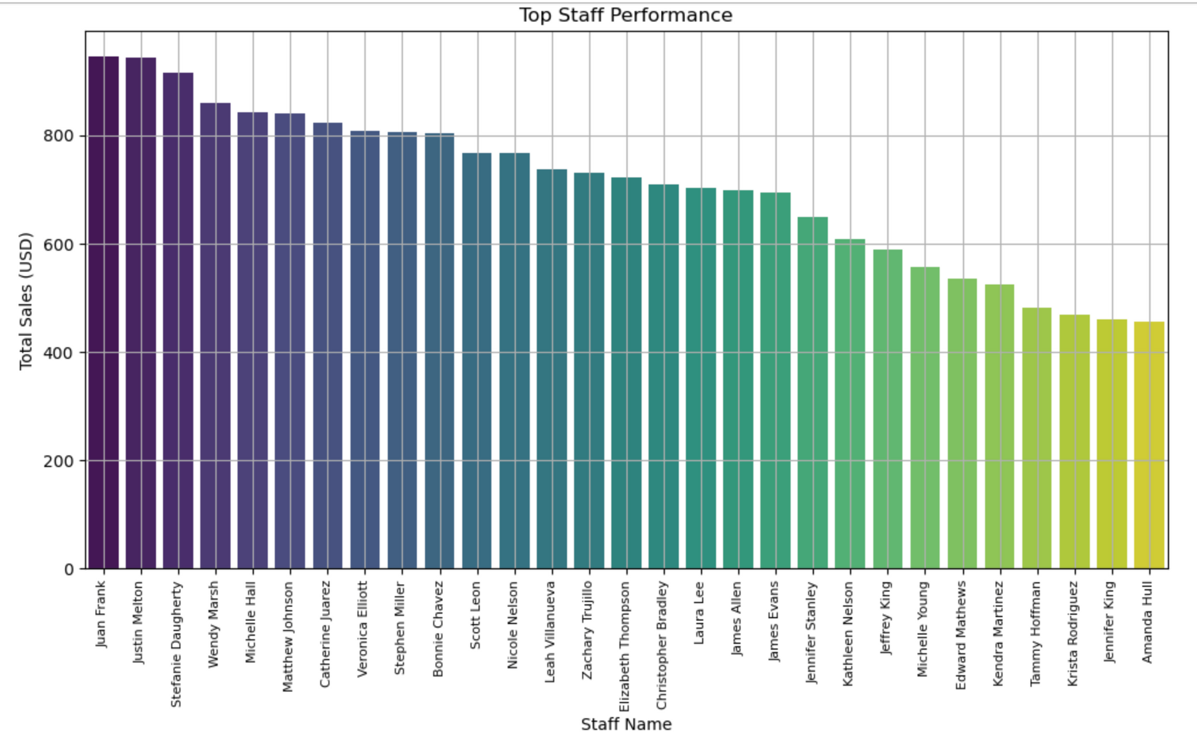
TOP STAFF PERFORMANCE

Slide 20
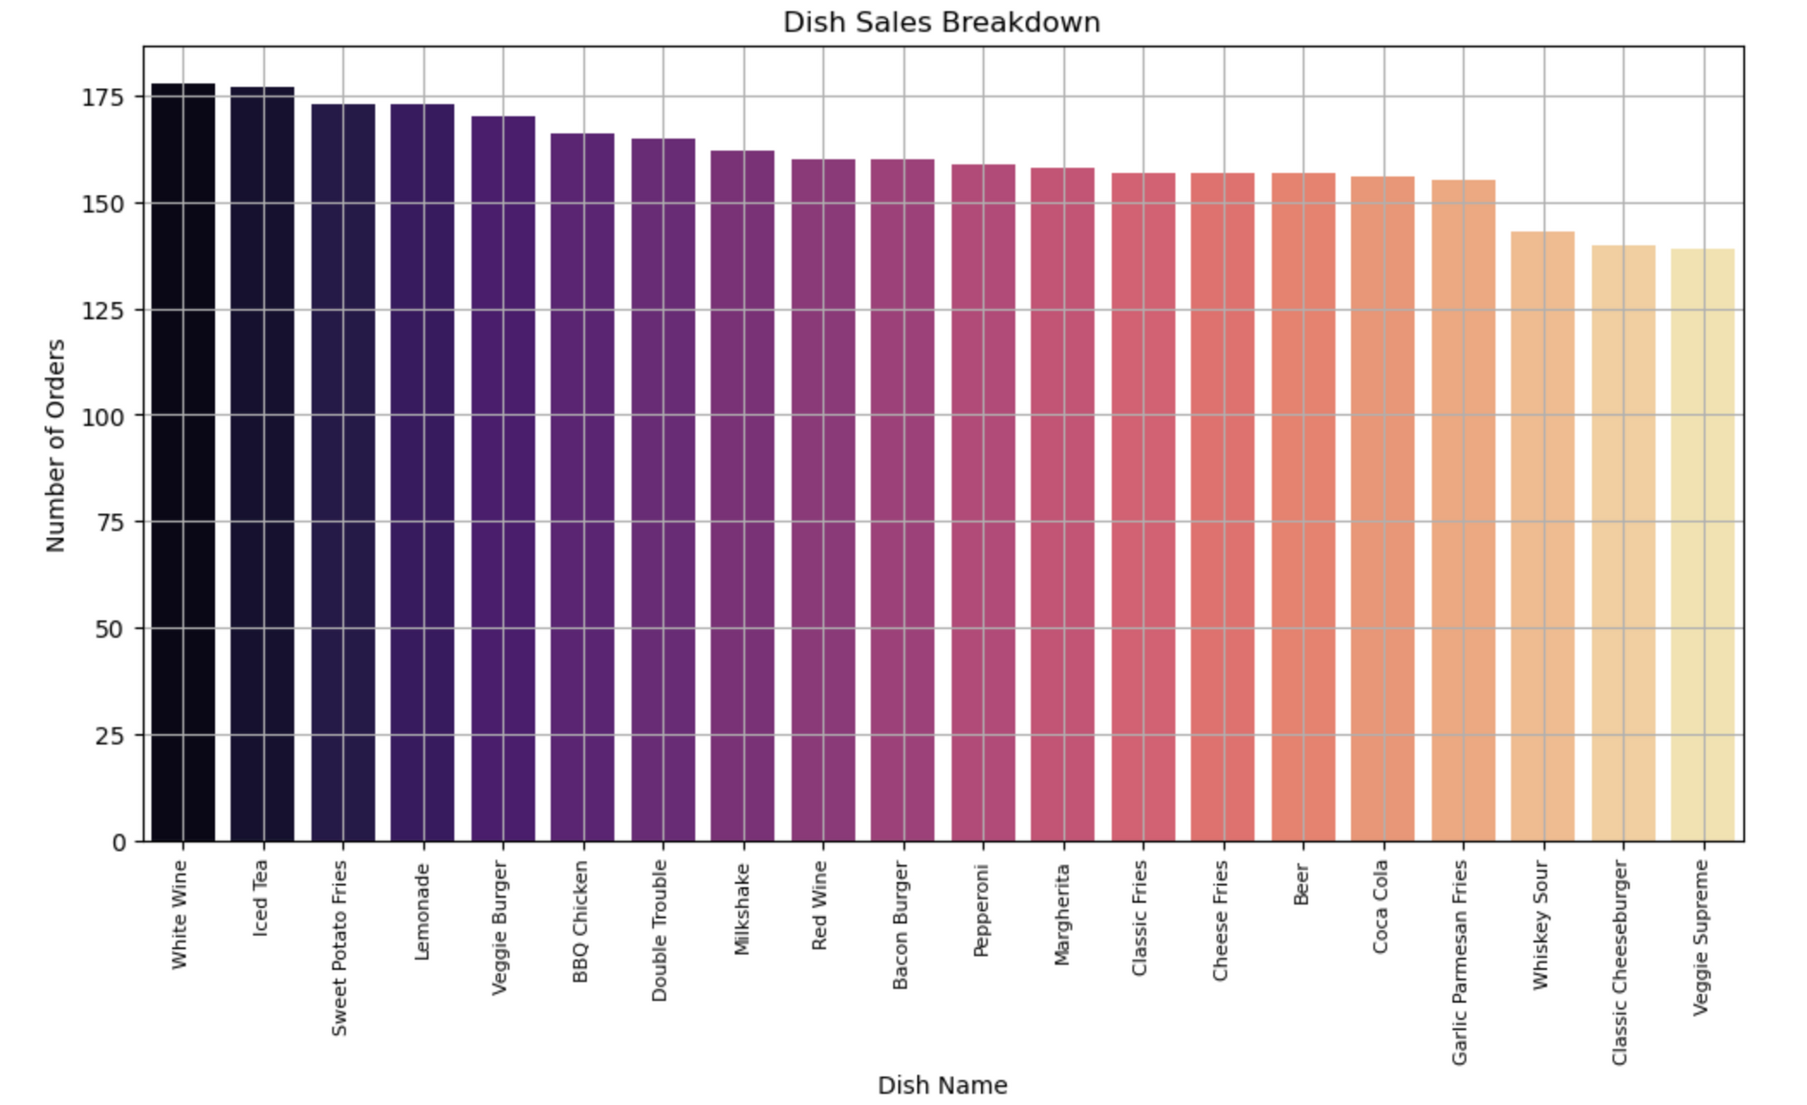
DISH SALES BREAKDOWN

Slide 21
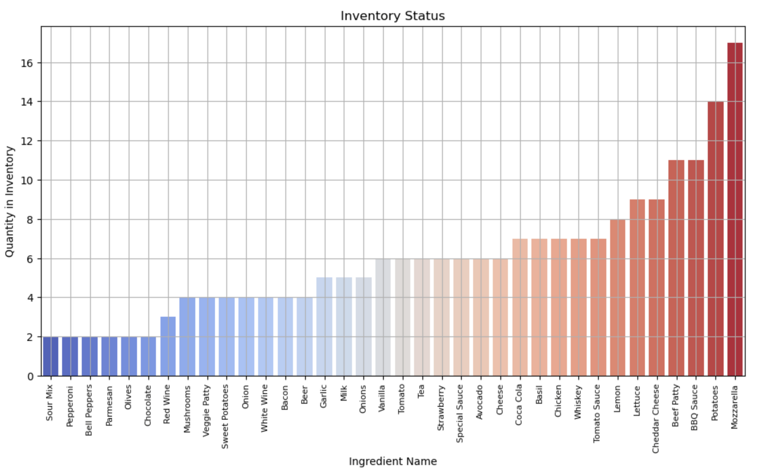
INVENTORY STATUS

Slide 22





THANK YOU!

